Slide 1
A CASE STUDY ON LOGIC GATES
Group members:- Danish Solkar, Fatir Khan, Farzan Khan, Ansari Mohd Hamza
Department:- Computer Engineering
Institute:- AI’S ARKP
Guide:- Hafsah Ma’am

Slide 2
INTRODUCTION OF THE PROJECT
Study of basic logic gates – AND, OR, NOT, NAND, NOR, EXOR, EXNOR
Demonstration using simple hardware circuits
Connects Boolean algebra theory with practical electronics
Aims to understand how digital systems process binary data

Slide 3
SUMMARY
Logic gates perform specific logical operations on binary inputs
Implemented using 7400 series ICs
Output displayed through LED indicators
Helps visualize truth tables and circuit behavior
Strengthens practical and theoretical understanding of digital logic

Slide 4
OBJECTIVES
To study the operation and truth tables of basic logic gates
To design breadboard circuits using ICs
To understand hardware implementation of Boolean logic
To develop analytical and troubleshooting skills
To establish a foundation for advanced digital design

Slide 5
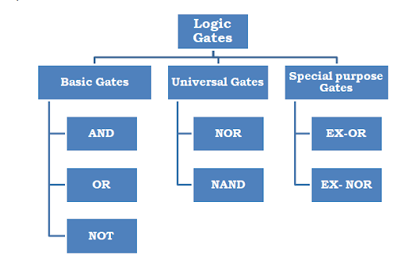
LOGIC GATES CLASSIFICATION

Slide 6
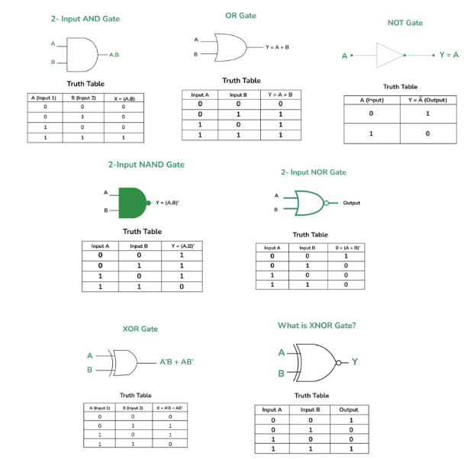
GATES AND TRUTH TABLE

Slide 7
HISTORY OF LOGIC GATES
George Boole (1854): Introduced Boolean algebra
Claude Shannon (1937): Applied Boolean logic to electrical circuits
1958: Invention of integrated circuits (ICs) by Jack Kilby & Robert Noyce
Evolution from mechanical relays → transistors → CMOS ICs
Foundation for modern computers and automation systems

Slide 8
APPLICATIONS
Computers & Microprocessors: ALU operations, data flow control
Memory Circuits: Registers, RAM, ROM
Communication Systems: Encoders, decoders, multiplexers
Automation & Control: Traffic lights, doors, alarms, sensors
Instrumentation: Counters, timers, flip-flops, pulse generators
Foundation for combinational and sequential circuits

Slide 9
CONCLUSION
Logic gates form the core of all digital systems
The project demonstrated binary operations using ICs
Developed hands-on circuit design and testing skills
Bridged the gap between theory and practical realization
Builds a base for advanced studies in digital electronics

Slide 10
REFERENCES
Digital Electronics: Principles and Applications – Donald P. Leach, A.P. Malvino
Fundamentals of Digital Circuits – A. Anand Kumar
Datasheets: 7400, 7402, 7404, 7408, 7432, 7486
www.electronics-tutorials.ws
www.elprocus.com

